Slide 1
Introduction to Machine learning

Slide 2




Slide 3
Agenda….
Real life application of Machine learning.
Challenges before ML
How Did Machine Learning evolve ?
Why use Machine Learning ?
Types of Machine learning?
Machine learning algorithms.
Machine learning Breakthroughs.

Slide 4

Real life application of Machine learning..

Slide 5
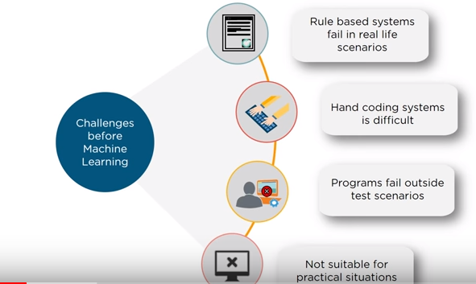
Challenges before machine learning.

Slide 6
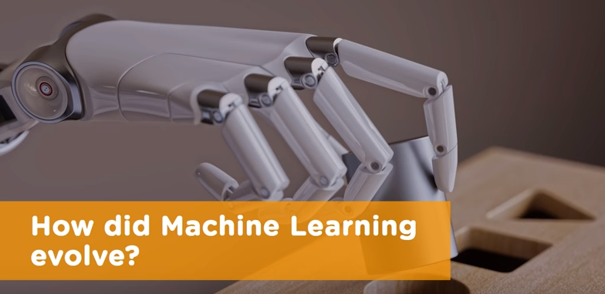

Slide 7
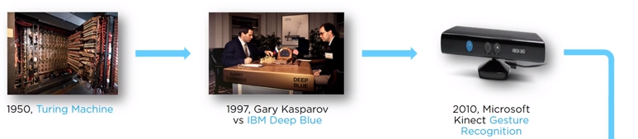

Machine Learning Timeline

Slide 8
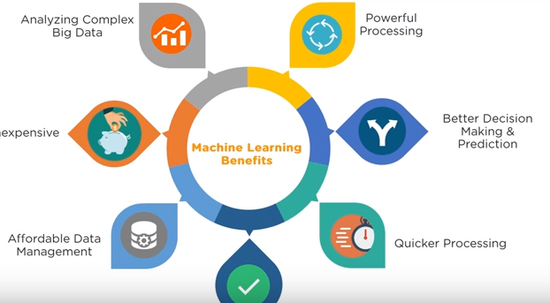

Why Machine Learning

Slide 9
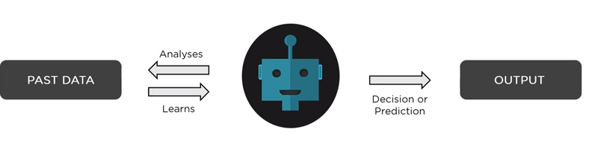
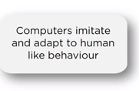


What is Machine Learning

Slide 10
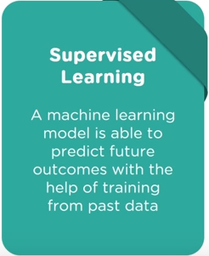


Types of Machine learning

Slide 11
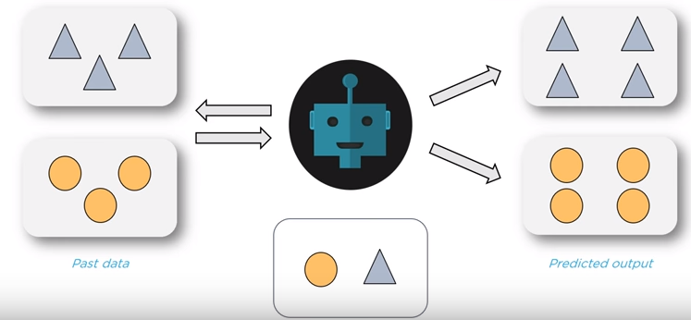
Supervised learning.

Slide 12
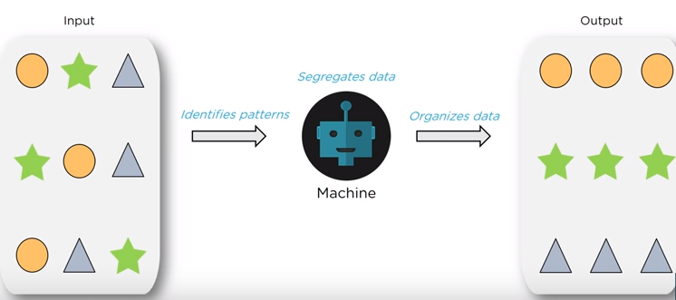
Unsupervised Learning

Slide 13
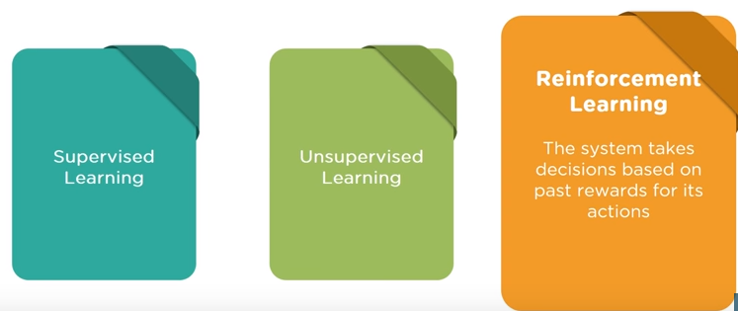
Reinforcement Learning.

Slide 14
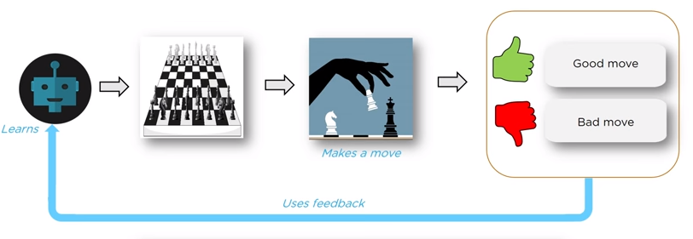

Reinforcement Learning.
Notes:
Supervised learning--- Making Predictions
Unsupervised learning – Finding Hidden Patterns
Three Things Involved in RF—
Decesion
Feedback
Learning

Slide 15
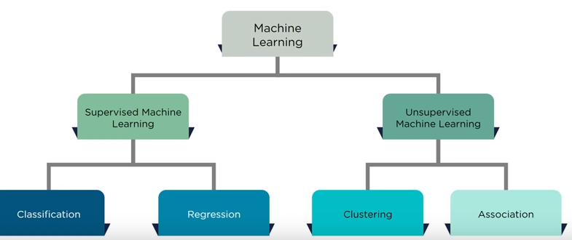
Machine Learning Algorithms

Slide 16
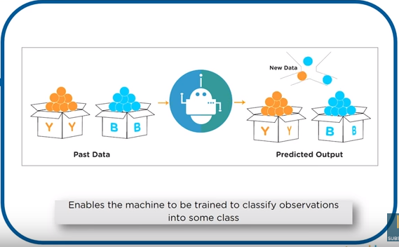
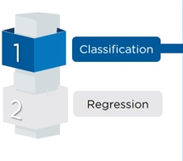
Supervised Machine Learning- Classification

Slide 17
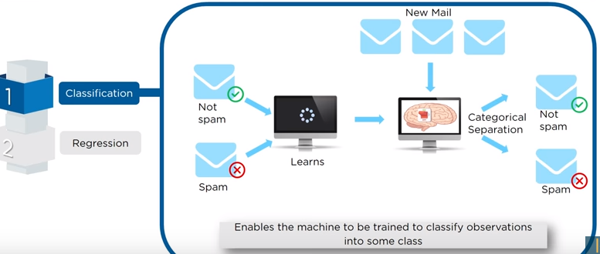
Supervised Machine Learning- Classification

Slide 18
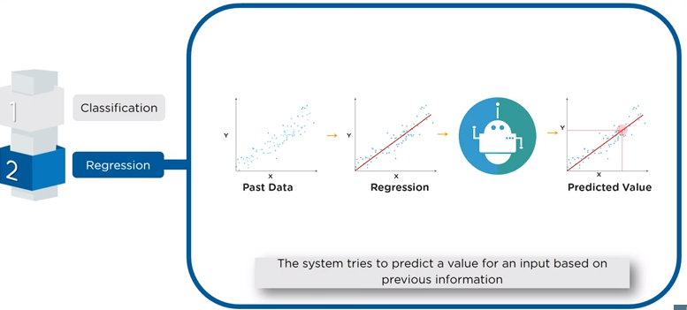
Supervised Machine Learning- Regression

Slide 19
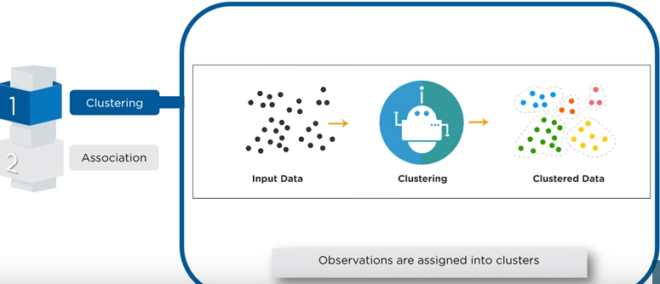
Unsupervised Learning-Clustering

Slide 20
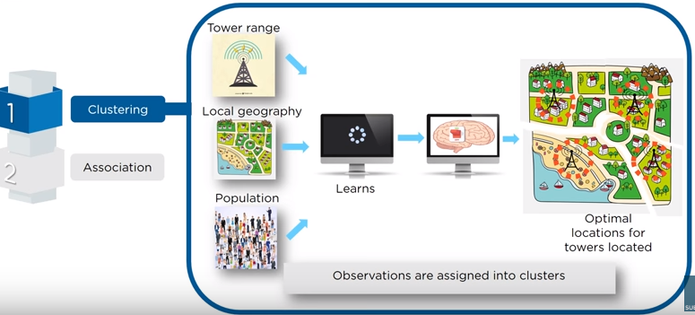
Unsupervised Learning-Clustering

Slide 21
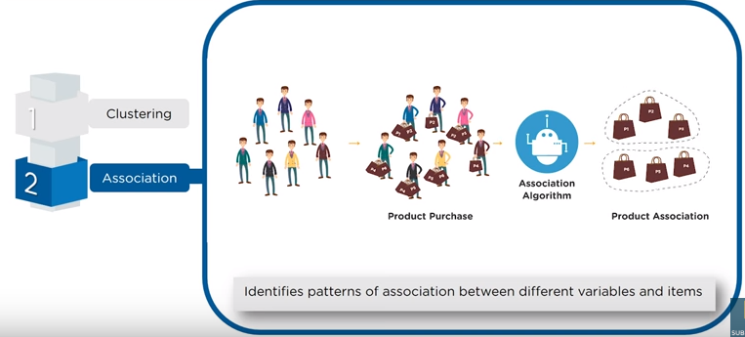
Association

Slide 22
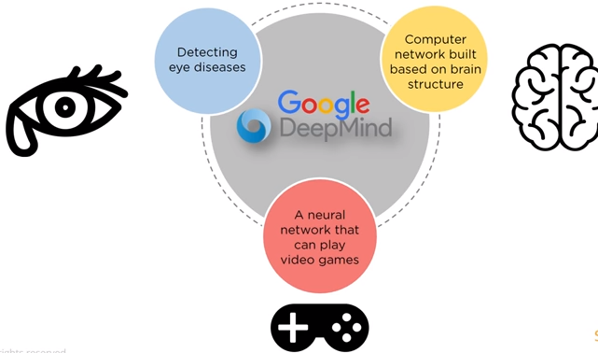
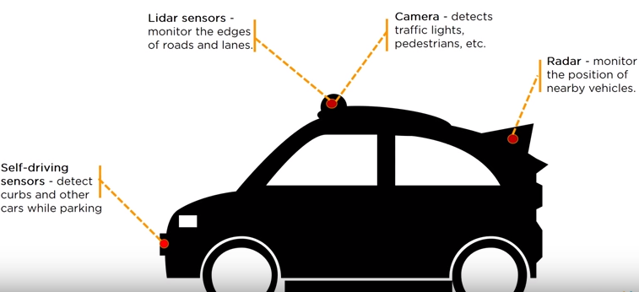
Breakthroughs in Machine learning

Slide 23


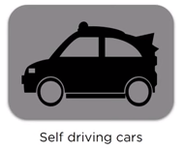
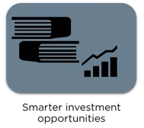
Future of Machine Learning

Slide 24
Thank you….

